Slide 1
Blood Vessel Disorders :
Aneurism – weakening & swelling of a blood vessel Most common in the aorta due to the high pressure
Hypertension – High blood pressure 140/90 or higher 1 out of 5 people have high blood pressure
Varicose Veins – Swollen superficial vessels usually found in the lower extremities (Varicose = inflamed)
DVT – Deep Vein Thrombosis - Clots that form in the deep veins of the lower legs due to inactivity or poor circulation can move to the heart and lungs – Very dangerous and often fatal if not detected and treated.
Angina – a temporary lack of blood to the heart muscle caused by physical or emotional stress.
Heart Attack – AMI – Acute Myocardial Infarction – Death of heart tissue due lack of blood carrying oxygen caused by a blockage of a coronary artery.

Slide 2
Shock is reduced blood flow throughout the body due to loss of blood or psychological stress.
Younger people can compensate for shock so they may seem fine but can suddenly show symptoms so plan ahead and treat for shock early.
Treatment for shock:
1. Call 911
2. Have the person lay down
3. Keep the person warm
4. If the person feels dizzy or confused slightly elevate the legs to improve blood supply to brain. If the injury involves trauma to the head or lungs don’t elevate the legs.
5. Don’t give anything to eat or drink, if the person becomes unconscious this may cause problems.

Slide 3
Heart Attack – symptoms
Pain or heavy feeling in the chest
Pain may radiate into left arm and jaw
Labored or difficulty breathing
Nausea may feel like indigestion or heartburn
Sweating (Diaphoresis)
Person will deny they are having a heart attack
Treatment –
Call 911
Have the person rest in position of comfort this can be sitting or laying down, many people having a heart attack don’t like laying down.
If the person is thirsty have them suck on a wet cloth don’t give food or water.
If the person becomes unconscious begin CPR

Slide 4
Immune System
Defends the body against invading antigens
1. Barrier – Skin, mucous membranes, tears, ear wax
2. Inflammatory Response – Histamines & Prostaglandins
3. Immune Response – Lymphocytes T & B

Slide 5
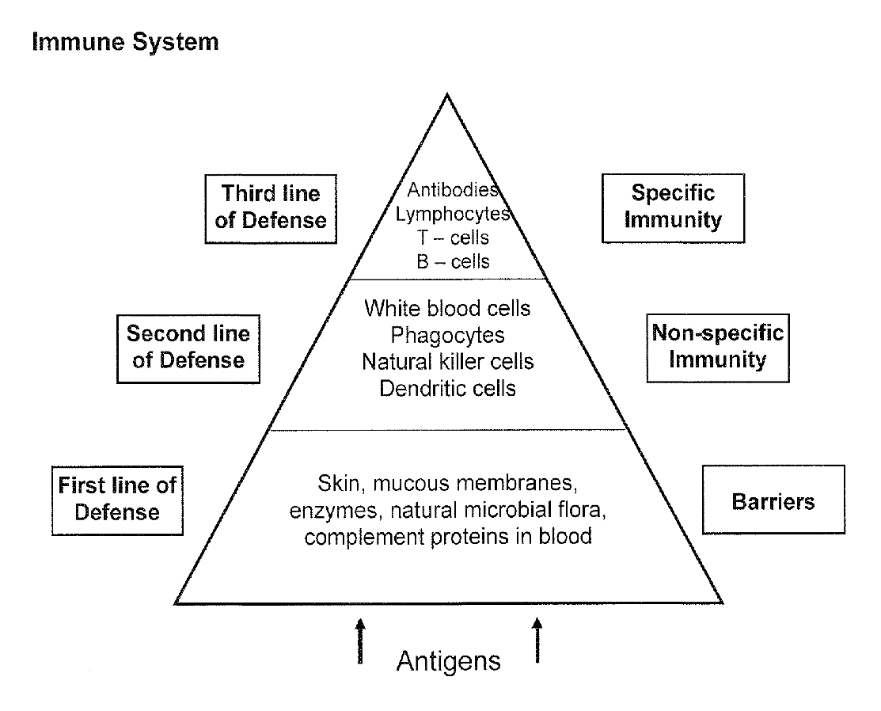

Slide 6
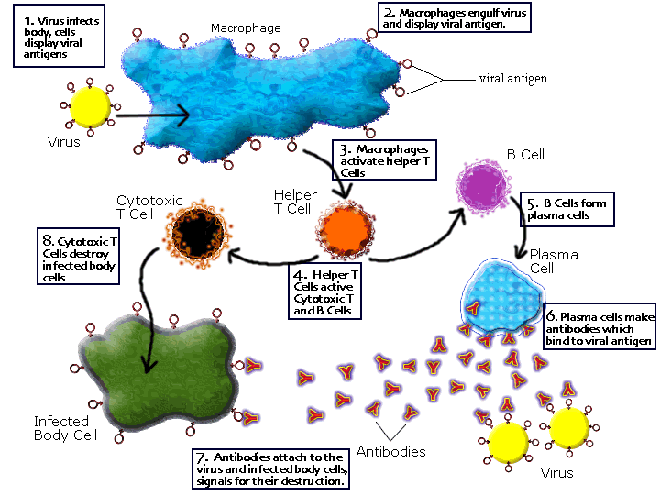
Immune Response
Dendritic cells
in lymph nodes

Slide 7
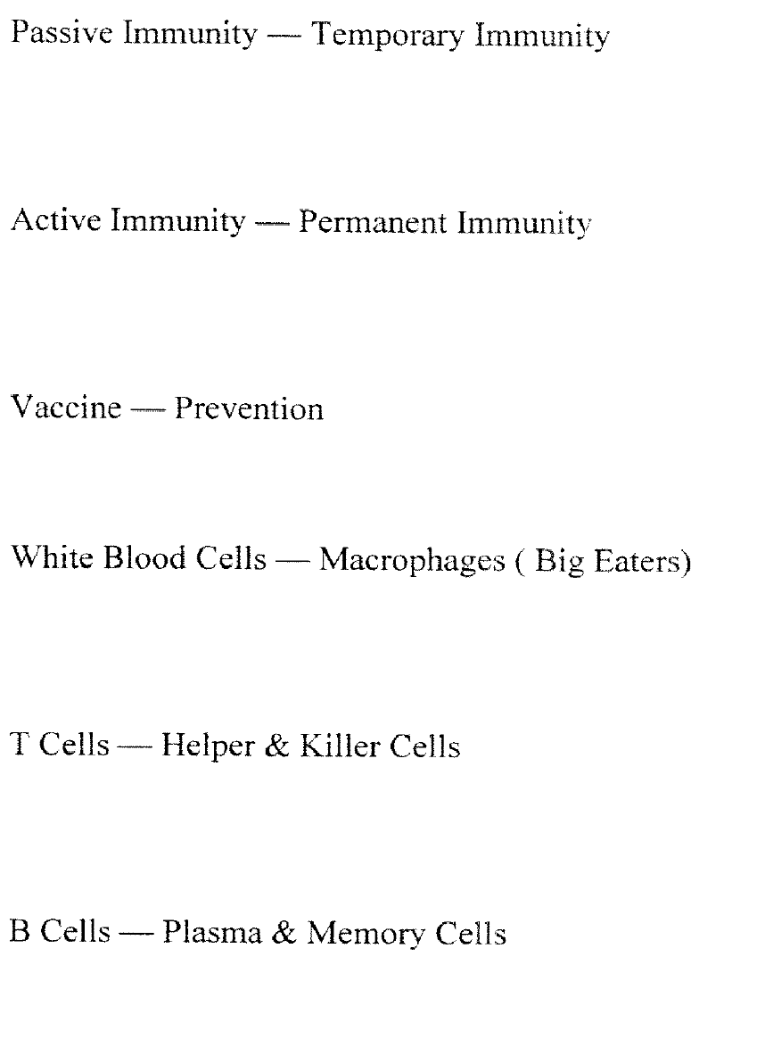

Slide 8
Lymphatic System
Specialized branch of the circulatory system involved with the protection of the body from invading antigens.
Active Immunity – You have had the disease or been given a vaccine that allowed you to developed immunity against the disease, only works with viruses.
Long lasting protection.
Passive Immunity – Borrowed immunity from another person or you are given mediation that will block the disease.
Short term protection

Slide 9
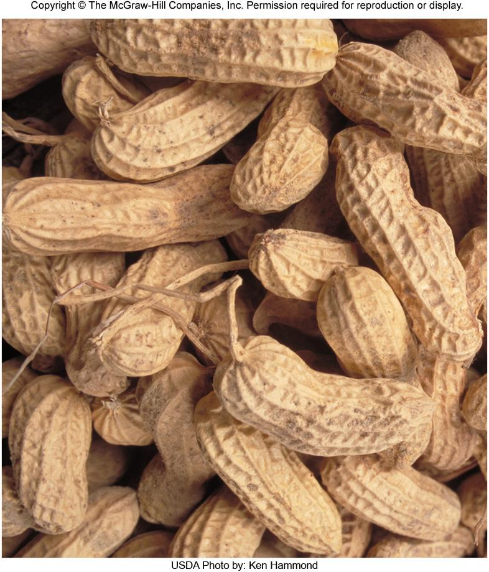
Chapter 14 Opener
Allergies

Slide 10
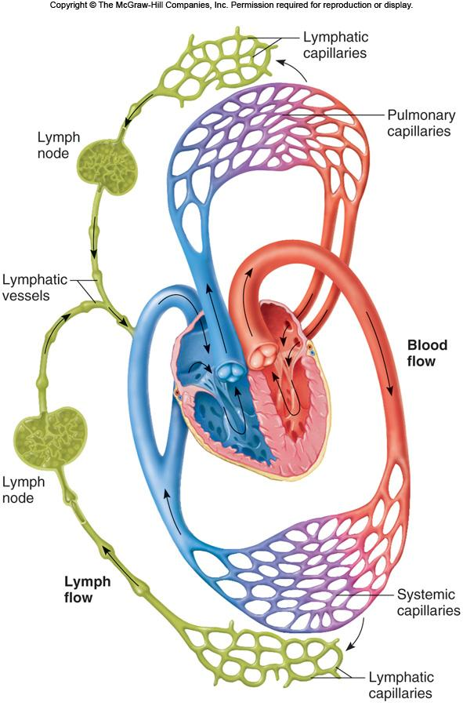
Figure 14.01

Slide 11
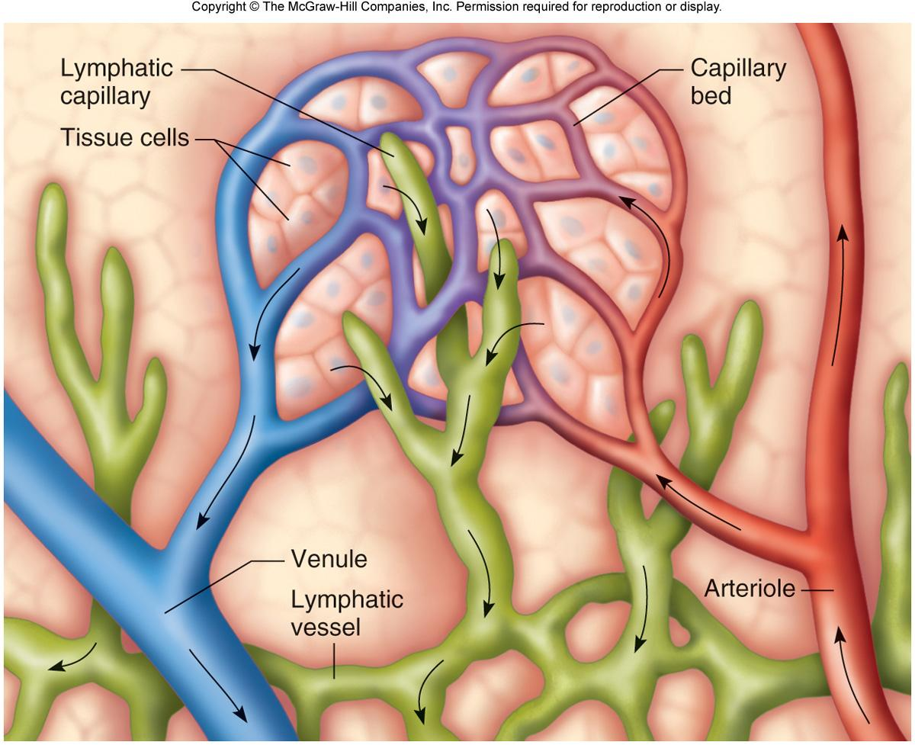
Figure 14.02

Slide 12
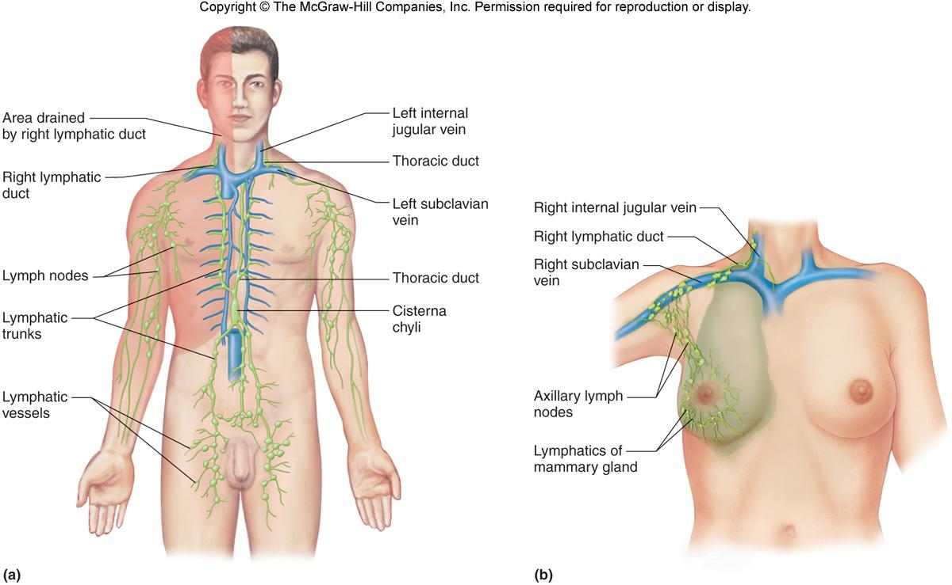
Figure 14.04

Slide 13
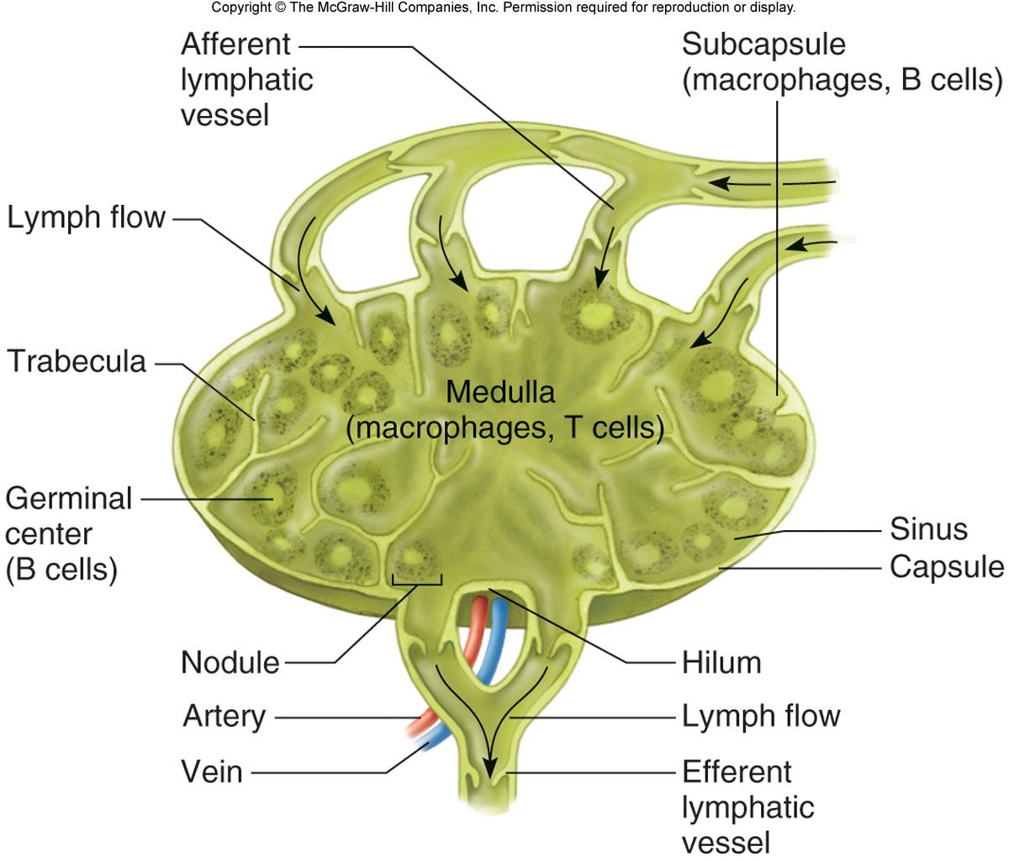
Figure 14.06

Slide 14
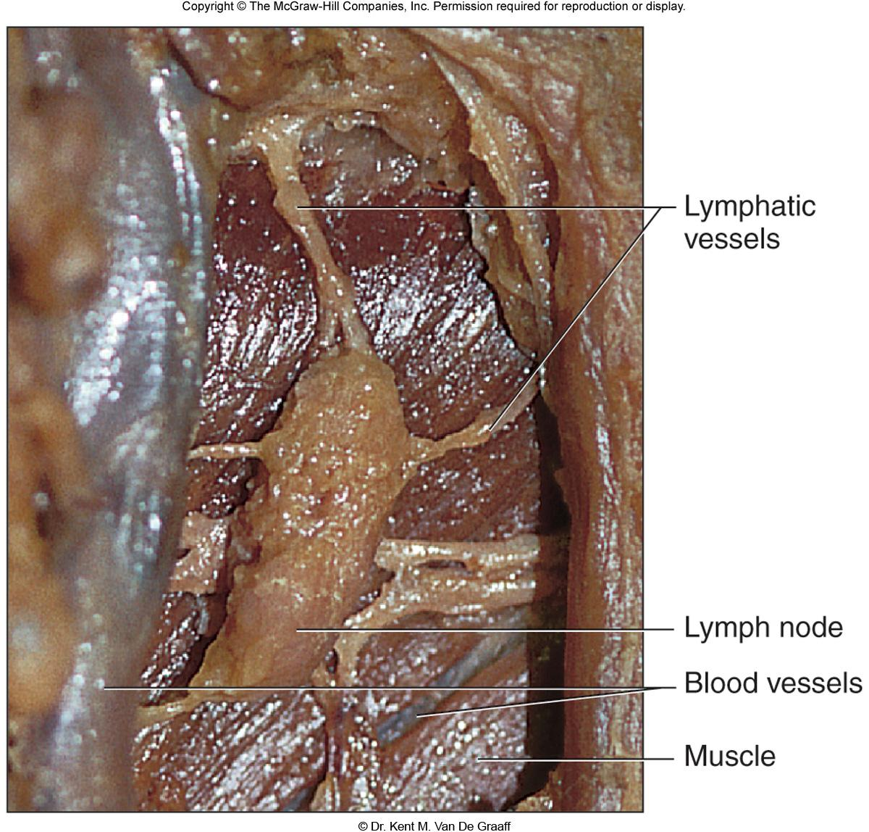
Figure 14.07

Slide 15
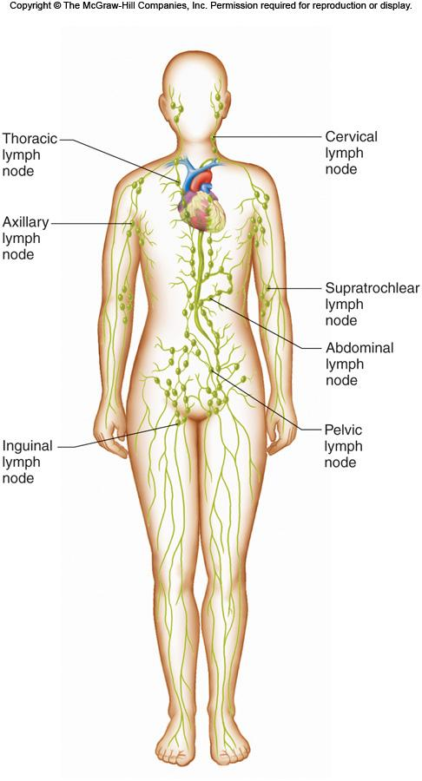
Figure 14.08

Slide 16
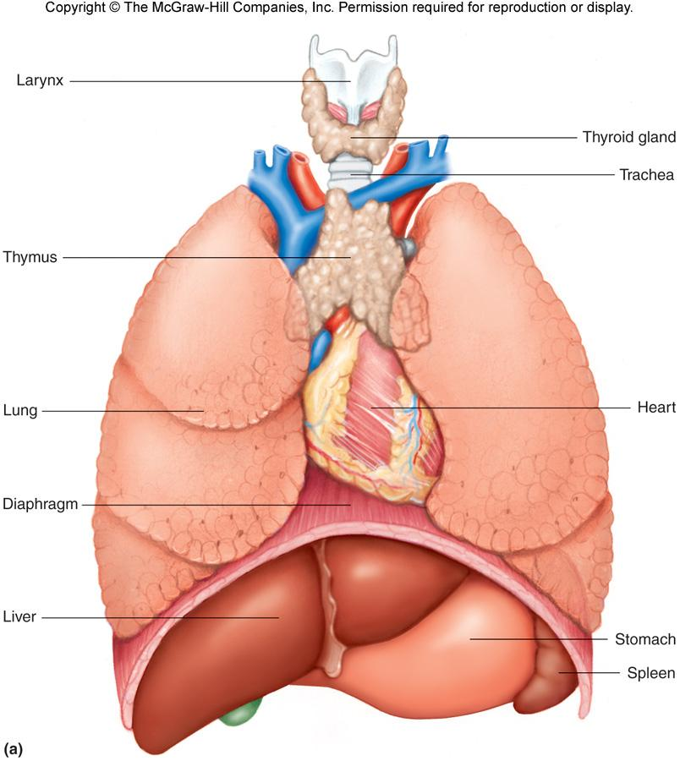
Figure 14.09a

Slide 17
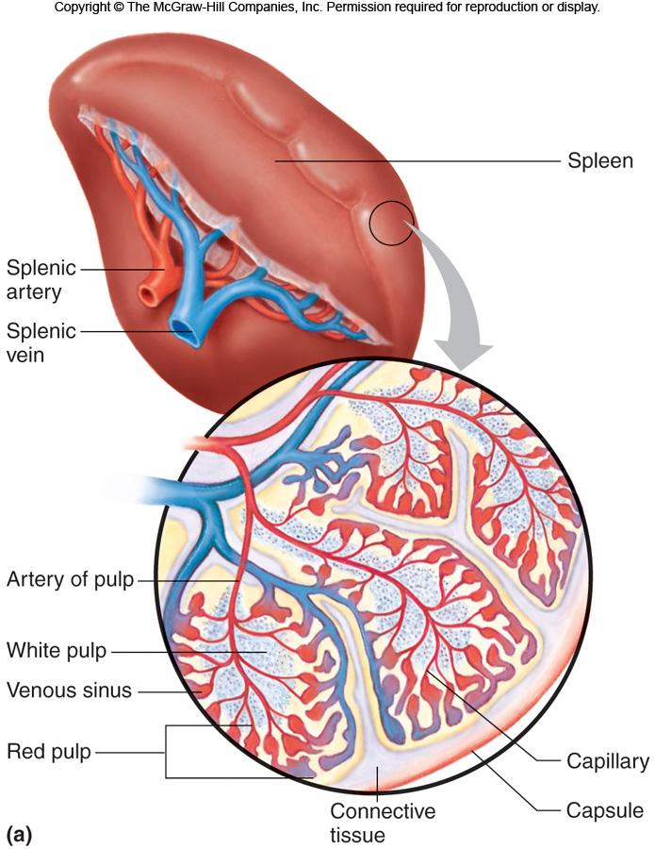
Figure 14.10a

Slide 18
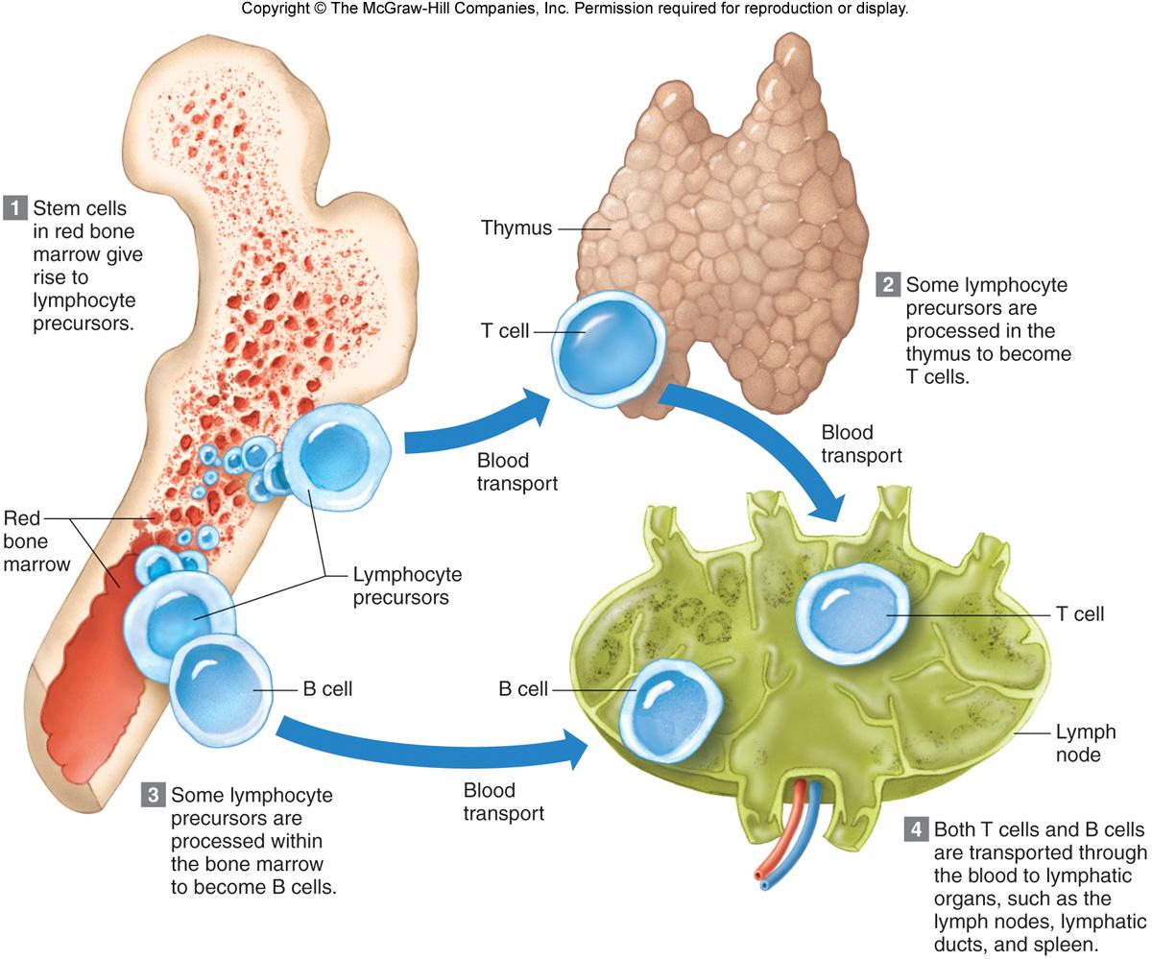
Figure 14.11

Slide 19
TABLES

Slide 20
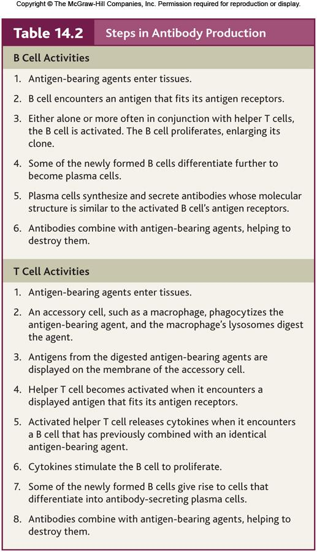
Table 14.02

Slide 21
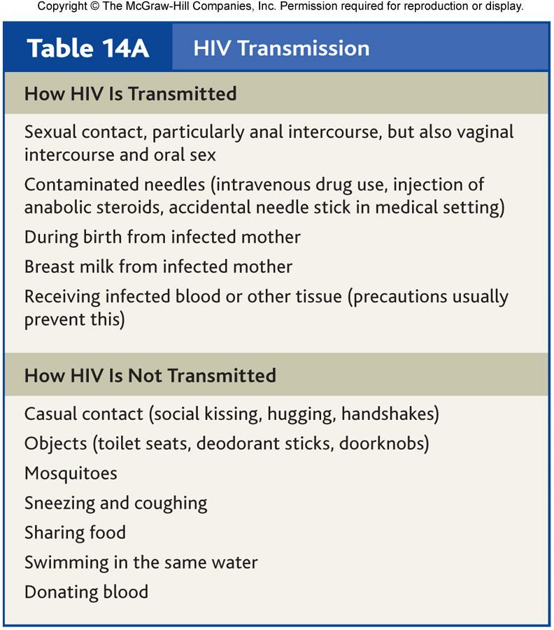
Table 14.A

